Slide 1
Pre-processing
Label Encoding
produit | profil_prm
type_d_offre | couleur_tarif_elec
type_de_prix | type_client
canal_de_vente | libelle_naf
zone | activite_nce
marche_de_la_sc | orientation_economique
segment_societe_contractante | entite_societe_contractante

Slide 2
Pre-processing
Treat Missing Values
Variable | Treatment
type_de_prix | « Autre »
zone | « Autre »
profil_prm | « Autre »
couleur_tarif_elec | « Autre »
volume_annuel | Mean value of same profil_prm
prix_gaz_m3 | Mean value
Variable | Treatment
prix_elec_m3 | Mean value
type_client | « Autre »
libelle_naf | « Autre »
activite_nce | « Autre »
anciennete_client | Mean value
orientation_economique | « Autre »

Slide 3
Pre-processing
Dropping unwanted variables
Train dataset Undersampling
echeance_annee | urbanite_ruralite
population | nb_atifs
evolution_pop_percent | dynamique_demographique_bv
nb_proprietaire | environnement_demographique
nb_logement | seg_dyn_entre
dep_moyenne_salaires_horaires

Slide 4
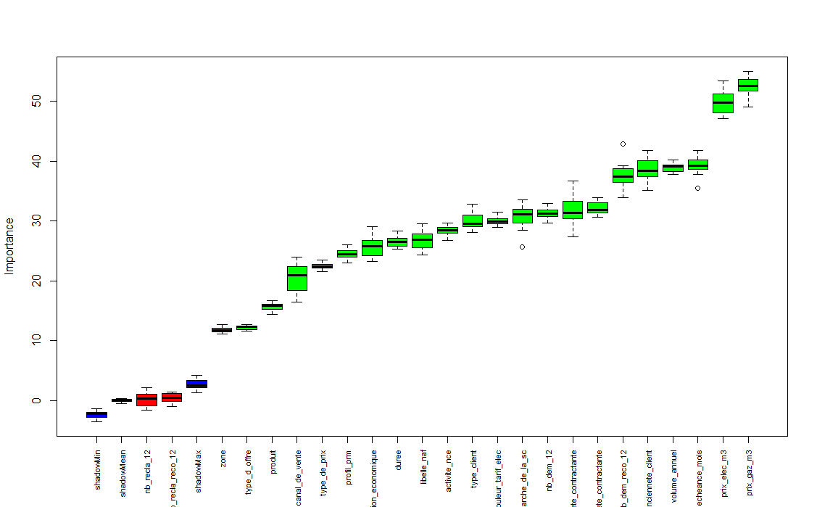
Feature Importance

Slide 5
Feature Importance
Boruta feature importance
meanImp medianImp minImp maxImp normHits decision
activite_nce 28.45905489 28.4309349 26.8064070 29.697286 1.0000 Confirmed
anciennete_client 38.80751166 38.3531654 35.1548906 41.766511 1.0000 Confirmed
canal_de_vente 20.42779487 20.9678583 16.4254381 23.948003 1.0000 Confirmed
couleur_tarif_elec 29.97690662 29.8602999 29.0025298 31.502614 1.0000 Confirmed
duree 26.50511289 26.4688960 25.2570018 28.386650 1.0000 Confirmed
echeance_mois 39.29527142 39.2880559 35.4338336 41.778321 1.0000 Confirmed
entite_societe_contractante 31.60392604 31.3540231 27.3306228 36.730157 1.0000 Confirmed
libelle_naf 26.75169638 26.8307901 24.3554271 29.539896 1.0000 Confirmed
marche_de_la_sc 30.63102843 31.0730306 25.6192420 33.493019 1.0000 Confirmed
nb_dem_12 31.21760156 31.2067957 29.6181758 32.894934 1.0000 Confirmed
nb_dem_reco_12 37.61405411 37.4769021 33.9112894 42.880744 1.0000 Confirmed
nb_recla_12 0.08512941 0.3352208 -1.5813958 2.130176 0.0625 Rejected
meanImp medianImp minImp maxImp normHits decision
nb_recla_reco_12 0.46043892 0.4851781 -0.9694779 1.442453 0.0000 Rejected
orientation_economique 25.81449290 25.7654060 23.1963238 29.040747 1.0000 Confirmed
prix_elec_m3 49.78766833 49.7938082 47.1669998 53.419873 1.0000 Confirmed
prix_gaz_m3 52.50740775 52.5185215 48.9962497 55.044348 1.0000 Confirmed
produit 15.66885333 15.8104187 14.3608871 16.695744 1.0000 Confirmed
profil_prm 24.49538908 24.5134058 23.0121997 26.030528 1.0000 Confirmed
segment_societe_contractante 32.10267849 31.8338540 30.5979092 33.949447 1.0000 Confirmed
type_client 29.92004841 29.5725035 28.0626247 32.858355 1.0000 Confirmed
type_d_offre 12.21080777 12.3003544 11.6804283 12.667004 1.0000 Confirmed
type_de_prix 22.47309295 22.4170115 21.5858458 23.492299 1.0000 Confirmed
volume_annuel 38.94214382 39.1823067 37.7712807 40.234713 1.0000 Confirmed
zone 11.83205110 11.7729759 11.1172926 12.752747 1.0000 Confirmed

Slide 6
Models
Learning Methodology: Stacking (Framework H2O, H2O Ensemble)
Base learners | Meta learner
GBM (H2O) | GBM wrapper (H2O)
Random Forest (H2O)
Deeplearning (H2O)

Slide 7
Final Blend
Weighted Ensemble
(0.5) (0.25) (0.25)
Best submission AC
Best submission JD
Average Best submission AC & JD

Slide 8
Tools & Framework
Data Exploration | Data Pre-processing | Feature Importance | Models Training | Final Blend
Python 3.5.2 | Python 3.5.2 | Python 3.5.2 | Python 3.5.2 | Python 3.5.2
Pandas | Pandas | R 3.3.0 | R 3.3.0 | Pandas
LibreOffice Calc |  | Library Boruta (R & Python) | Scikit Learn (Python)
 |  |  | LightGBM (Python)
 |  |  | CatBoost (Python)
 |  |  | H2O 3.22 (R)
 |  |  | H2O Ensemble 0.2.1 (R)

